Slide 1
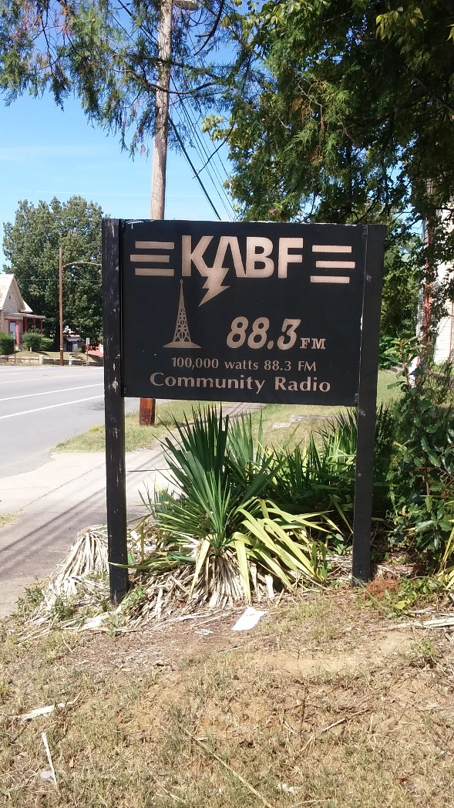

It Could Be You, September 13, 2017
With John R. and John S. talking about addiction, treatment
and recovery on KABF, 88.3 “The Voice of the People”

